Slide 1
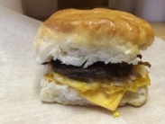
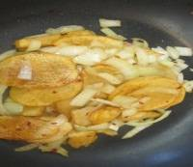
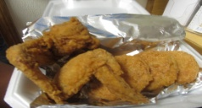
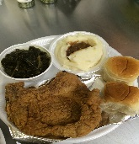
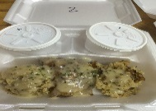
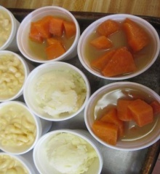
S&V BREAKFAST | S&V LUNCH/DINNER | S&V OTHER ITEMS
BISCUITS / WRAPS:
BOLOGNA/SAUSAGE/BAC/SALMON $3.00
BLT (Sandwich) ON TOAST $4.25
CHICKEN / COUNTRY HAM $3.50
BACON or SAUSAGE/EGG/CHEESE $3.50 EGG and CHEESE / GRAVY BISCUIT $2.00
BUTTER BISCUIT $1.00
Any WRAP $3.50
SIGNATURE DAGWOOD $4.25
BREAKFAST PLATTERS:
MEAT of CHOICE, EGGS, POTATOES or TOTS, BISCUIT or TOAST $6.85
COUNTRY SIDES:
BREAKFAST MEATS $1.95 – S2.00
GRITS / POTATOES / TOTS $1.75
EGG(1) $1.10
BREAKFAST DRINKS: $1.35-$3.75
OJ, Regular COFFEE, MILK, Specialty Coffee
“SUNDAY ONLY”
(1-6pm)
DAILY MEATS: (Extra Meat : $3.50 - $4.50)
(All meals served with 2 sides, bread, & drink) $8.99
CHICKEN & DRESSING (Dark Meat)
FISH (Catfish / Tilapia (Fried or Pan Seared)) ($9.99)
PORK CHOP or CHICKEN (Fried / Grilled)
CHICKEN FINGERS
COUNTRY FRIED STEAK & GRAVY
FRIED CHICKEN (WHITE (Extra $0.65))
CHITTERLINGS or OX TAILS (Occasional) ($13)
VEGGIE SIDES: ($1.95 Each) SEASONED!!!
CABBAGE / COLLARDS / GREEN BEANS
CORN CASSEROLE / MACARONI & CHEESE
FRIED GREEN TOMATOES ($2.25)
FRIED OKRA / PINTO BEANS
FRIES / Sweet Potato FRIES
MASHED POTATOES & GRAVY
POTATO SALAD / YAMS
VEGGIE PLATE (3) ($5.85)
PINTOS & CORNBREAD ($4.50)
COMBINATION MEALS
FISH w/PORKCHOP or CHICKEN $13
CHICKEN w/PORKCHOP $12
LIVERS w/GIZZARDS $11
HOMEMADE DESSERTS!!!
($2.50 - $3.50) per SLICE
SANDWICHES: (Served w/Side)
TURKEY / HAM CLUB $6.25
FRIED BOLOGNA SANDWICH $5.80
FRIED / GRILLED PORKCHOP $7.50
FRIED / GRILLED CHICKEN $6.75
FRIED FISH SANDWICH $7.80
JJ’s REGULAR HAMBURGER $5.75
Combo $6.75
JJ’s CHEESEBURGER $6.25
Combo $7.25
CHICKEN QUESADILLA $7.75
PIZZA GRILLED CHEESE $5.75
REGULAR GRILLED CHEESE $4.25
KID’S MEAL $5.85
(10 & Under; Meat, (1) One Side, Bread, & Drink)
REGULAR DRINKS: $1.85(Refills: $0.50)
Coke, Diet Coke, Dr. Pepper, Mello Yello, Sprite, Pink Lemonade, Sweet Tea, Un-Sweet Tea
SPECIALTY DRINKS: $2.00(Refills: $1.00)
S&V PeachADE
S&V LemonADE
S&V PineApple Tea
*SOUL-FOOD
SUNDAY SAMPLER
$10.99 - $11.99
Call in: 256-715-0786 Oak Park Shopping Center
Open 8-7pm M-F, 11-7pm Sat, 1-6pm Sun:
1407 North Memorial Pkwy, Suite 18
Huntsville, Alabama 35810 (Across from Krogers)

